Slide 1

PYTHON
Loop Control Statements

Slide 2

OBJECTIVES
About Python loop Control Statement
Continue
Break
Pass

Slide 3
Loop Control Statements
Loop control statements change execution of the loop from its normal sequence.
Python supports following control statements:
Break
Continue
Pass

Slide 4
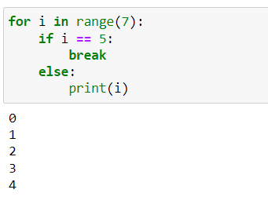
BREAK
The Break statement terminates the loop in which they are present:
Example:

Slide 5
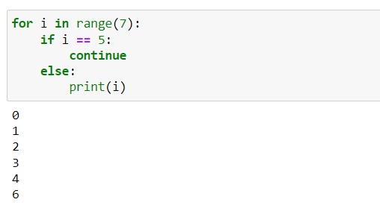
CONTINUE
When the condition for continue in satisfied then that step of the iteration is skipped or not included, and execution moves on to the next iteration of loop.
Example:

Slide 6
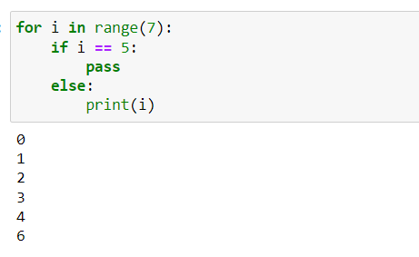
PASS
In python pass is a null statement and don’t do anything, they are basically placed so that the programmer can code at that place in future.

Slide 7

SUMMARY
Python loop control statement help us to manage loops such as breaking out of loop or skipping an iterations.
Break statement makes the loop terminates
Continue statement skips the corresponding iteration.
Pass do nothing.
Notes:
https://www.w3schools.com/python/python_ref_string.asp

